Slide 1
Chapter 4: Threads

Slide 2
Chapter 4: Threads
Overview
Multithreading Models
Thread Libraries
Threading Issues
Operating System Examples
Windows XP Threads
Linux Threads

Slide 3
Objectives
To introduce the notion of a thread — a fundamental unit of CPU utilization that forms the basis of multithreaded computer systems
To discuss the APIs for the Pthreads, Win32, and Java thread libraries
To examine issues related to multithreaded programming

Slide 4

Single and Multithreaded Processes

Slide 5
Benefits
Responsiveness
Resource Sharing
Economy
Scalability

Slide 6
Multicore Programming
Multicore systems putting pressure on programmers, challenges include:
  Dividing activities
  Balance
  Data splitting
  Data dependency
  Testing and debugging

Slide 7

Multithreaded Server Architecture

Slide 8
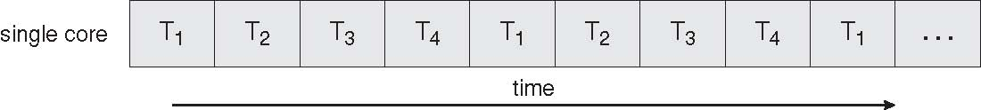
Concurrent Execution on a Single-core System

Slide 9
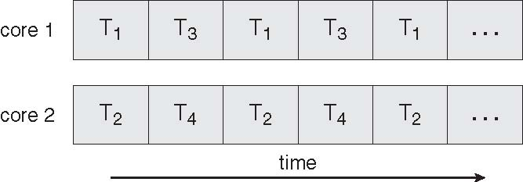
Parallel Execution on a Multicore System

Slide 10
User Threads
Thread management done by user-level threads library
Three primary thread libraries:
  POSIX Pthreads
  Win32 threads
  Java threads

Slide 11
Kernel Threads
Supported by the Kernel
Examples
  Windows XP/2000
  Solaris
  Linux
  Tru64 UNIX
  Mac OS X

Slide 12
Multithreading Models
Many-to-One
One-to-One
Many-to-Many

Slide 13
Many-to-One
Many user-level threads mapped to single kernel thread
Examples:
  Solaris Green Threads
  GNU Portable Threads

Slide 14
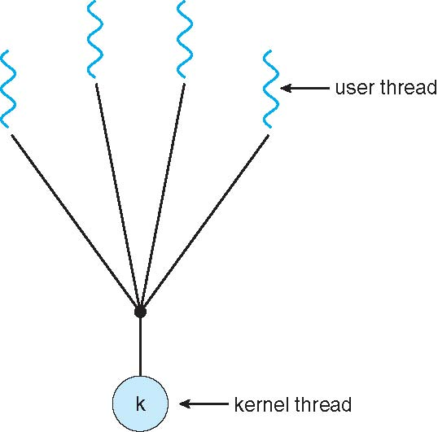
Many-to-One Model
Many user-level threads mapped to one kernel thread
Advantage:
  Thread management in user space
  Hence, efficient
Disadvantages:
  One thread blocking causes all to block
  Multiple threads may not run in parallel on multicore system
    Since only 1 may be in kernel at a time
    Few systems currently use this model

Slide 15
One-to-One
Each user-level thread maps to kernel thread
Examples
  Windows NT/XP/2000
  Linux
  Solaris 9 and later

Slide 16
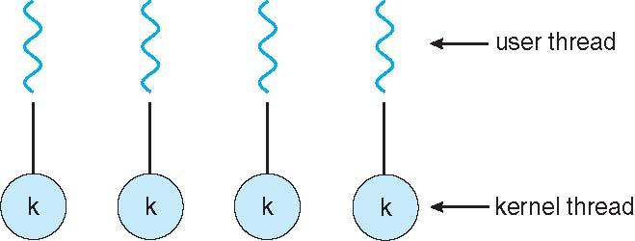
One-to-one Model
Each user-level thread maps to one kernel thread
Creating a user-level thread creates a kernel thread
Advantages:
  More concurrency than many-to-one model
Disadvantages:
  High overhead of creating kernel threads
  Number of threads per process sometimes restricted

Slide 17
Many-to-Many Model
Allows many user level threads to be mapped to many kernel threads
Allows the operating system to create a sufficient number of kernel threads
Solaris prior to version 9
Windows NT/2000 with the ThreadFiber package

Slide 18

Many-to-Many Model
Many-to-one
  Any number of threads is allowed, but low concurrency
One-to-one
  Great concurrency, but the number of threads is limited
Many-to-many
  Gets rid of the shortcomings of the precious two models

Slide 19
Two-level Model
Similar to M:M, except that it allows a user thread to be bound to kernel thread
Examples
  IRIX
  HP-UX
  Tru64 UNIX
  Solaris 8 and earlier

Slide 20
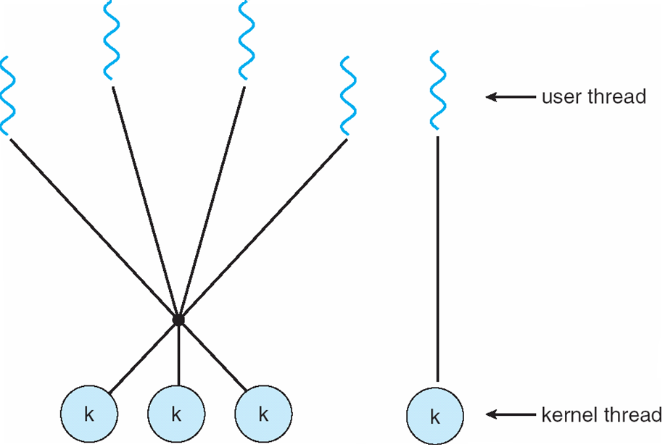
Two-level Model

Slide 21
Thread Libraries
Thread library provides programmer with API for creating and managing threads
Two primary ways of implementing
  Library entirely in user space
  Kernel-level library supported by the OS

Slide 22
Pthreads
May be provided either as user-level or kernel-level
A POSIX standard (IEEE 1003.1c) API for thread creation and synchronization
API specifies behavior of the thread library, implementation is up to development of the library
Common in UNIX operating systems (Solaris, Linux, Mac OS X)

Slide 23

Java Threads
Java threads are managed by the JVM
Java threads may be created by:
  Implementing the Runnable interface

Slide 24
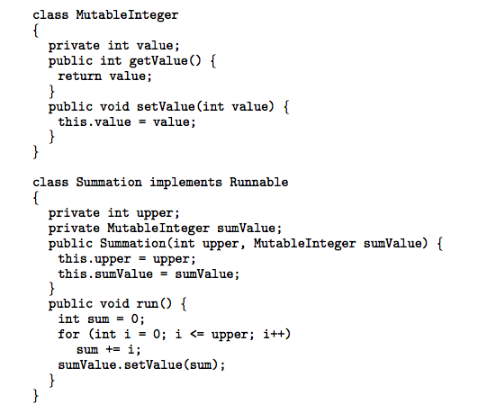
Java Threads - Example Program

Slide 25
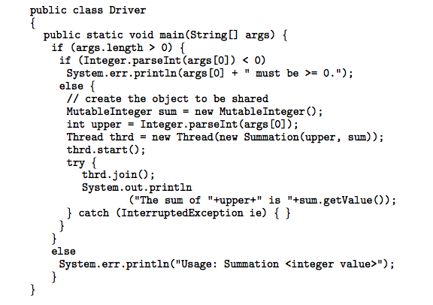
Java Threads - Example Program

Slide 26
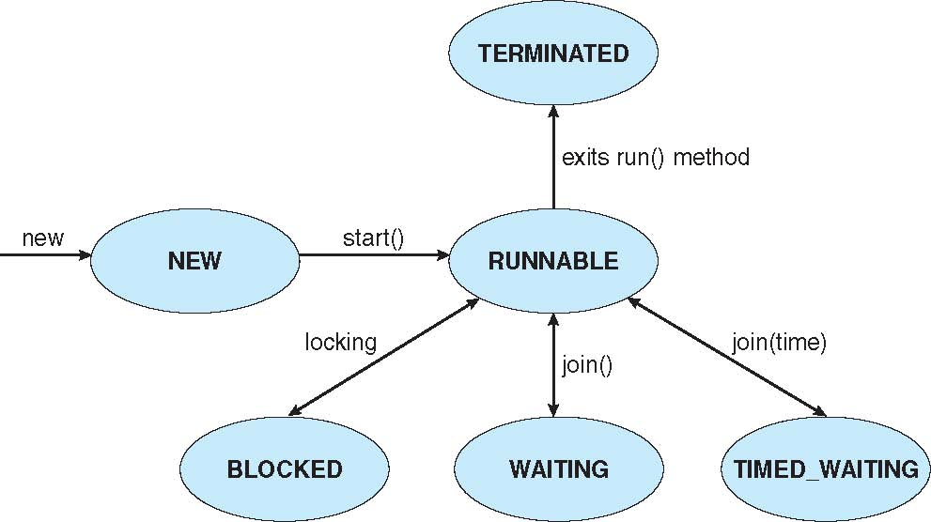
Java Thread States

Slide 27
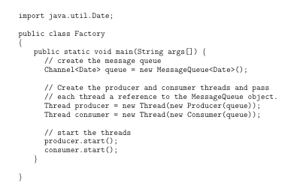
Java Threads - Producer-Consumer

Slide 28
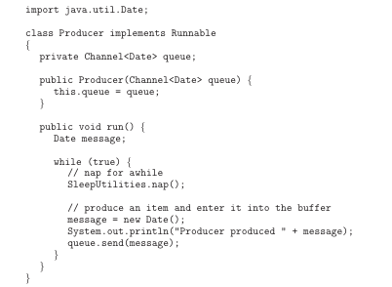
Java Threads - Producer-Consumer

Slide 29
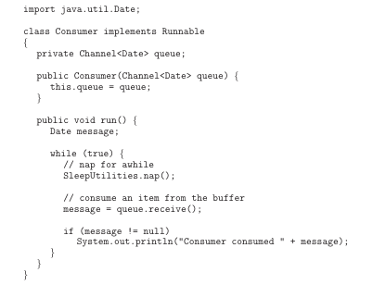
Java Threads - Producer-Consumer

Slide 30
Threading Issues
Semantics of fork() and exec() system calls
Thread cancellation of target thread
  Asynchronous or deferred
Signal handling
Thread pools
Thread-specific data
Scheduler activations

Slide 31
Semantics of fork() and exec()
Does fork() duplicate only the calling thread or all threads?

Slide 32
Thread Cancellation
Terminating a thread before it has finished
Two general approaches:
  Asynchronous cancellation terminates the target thread immediately
  Deferred cancellation allows the target thread to periodically check if it should be cancelled

Slide 33
Signal Handling
Signals are used in UNIX systems to notify a process that a particular event has occurred.
A signal handler is used to process signals.
  Signal is generated by particular event
  Signal is delivered to a process
  Signal is handled
Options:
  Deliver the signal to the thread to which the signal applies
  Deliver the signal to every thread in the process
  Deliver the signal to certain threads in the process
  Assign a specific threa to receive all signals for the process

Slide 34
Thread Pools
Create a number of threads in a pool where they await work.
Advantages:
  Usually slightly faster to service a request with an existing thread than create a new thread.
  Allows the number of threads in the application(s) to be bound to the size of the pool.

Slide 35
Thread Specific Data
Allows each thread to have its own copy of data
Useful when you do not have control over the thread creation process (i.e., when using a thread pool)

Slide 36
Scheduler Activations
Both M:M and Two-level models require communication to maintain the appropriate number of kernel threads allocated to the application
Scheduler activations provide upcalls - a communication mechanism from the kernel to the thread library
This communication allows an application to maintain the correct number kernel threads

Slide 37
Operating System Examples
Windows XP Threads
Linux Thread

Slide 38
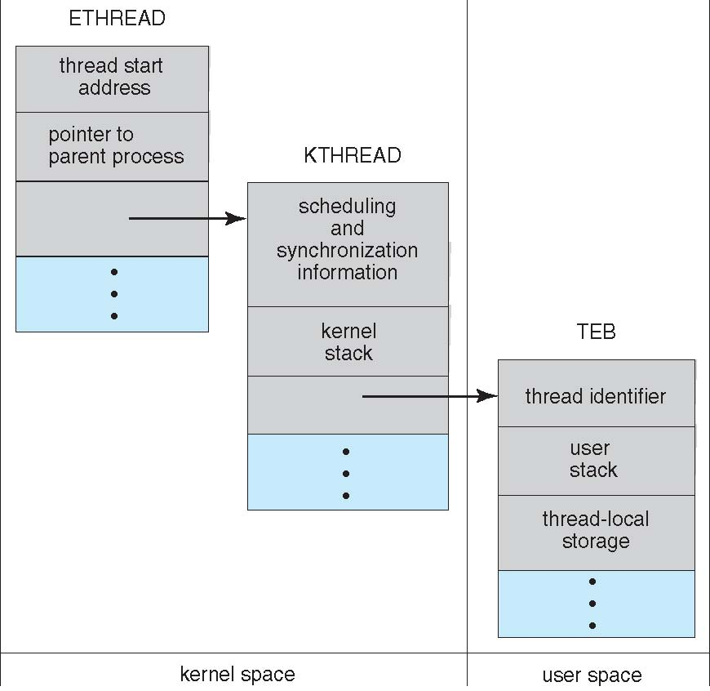
Windows XP Threads

Slide 39
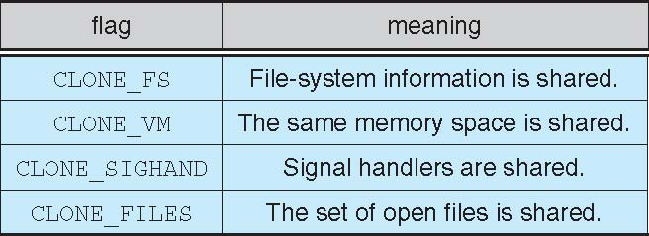
Linux Threads

Slide 40
Windows XP Threads
Implements the one-to-one mapping, kernel-level
Each thread contains
  A thread id
  Register set
  Separate user and kernel stacks
  Private data storage area
The register set, stacks, and private storage area are known as the context of the threads
The primary data structures of a thread include:
  ETHREAD (executive thread block)
  KTHREAD (kernel thread block)
  TEB (thread environment block)

Slide 41
Linux Threads
Linux refers to them as tasks rather than threads
Thread creation is done through clone() system call
clone() allows a child task to share the address space of the parent task (process)

Slide 42
End of Chapter 4

